Slide 1

DATA ANALYSIS WITH EXCEL
FOR BUSINESS

Slide 2
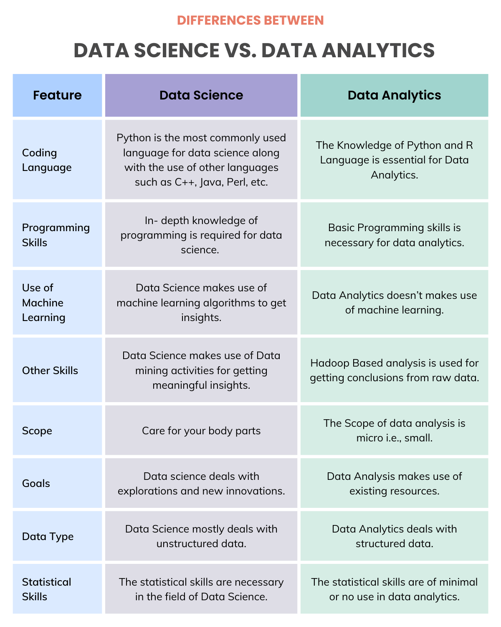
Scope of data science is macro
ie.; broad.

Slide 3
Definition
Data Analysis is the process of inspecting, cleaning, transforming and modelling data with the goal of discovering useful information, suggesting conclusions and supporting decision-making

Slide 4
Processes
Data Analysis Process consists of
Data Requirements Specification
Data Collection
Data Processing
Data Cleaning
Data Analysis
Communication

Slide 5
Excel Outline
Reading data
Data Manipulation
Arithmetic operations
Excel functions
IF and Nested IF
Data filtering
VLOOKUP and HLOOKUP
Pivot table
Charts

